Slide 1
Keep Calm and Make Music
Raindrops

Slide 2
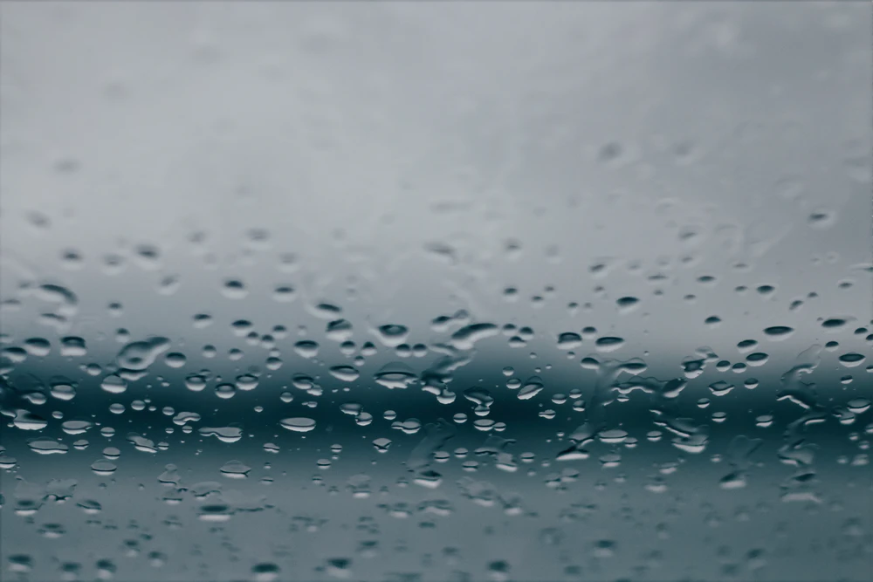
Raindrops
Listen to the song
Can you whisper the drip drop pattern at the beginning?
Listen again and keep the steady beat on your knees
Put on your wellies and move around the room in time to the steady beat
Can you make a rain sound by tapping your finger tips on the palm of your hand?

Slide 3
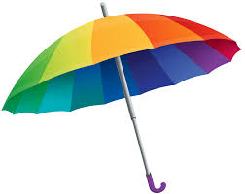
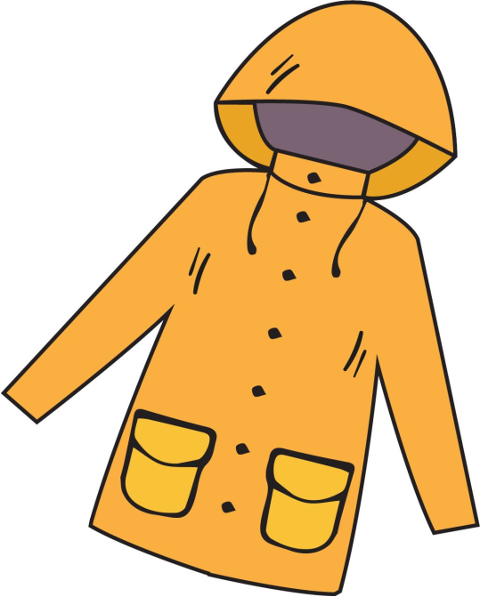
Don’t get wet!
What might you need for going out in the rain?
Can you think of them all?
Listen to the song and see which ones you are going to sing about

Slide 4
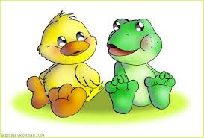
Listen again..
This time, try tapping the drip drop pattern – it goes like this:
drip drop drip-drip drop
Try tapping it while you listen to the song all the way through and join in with the whispers when you hear them.
Try singing the song – see how much you can join in with
Listen out for and

Slide 5
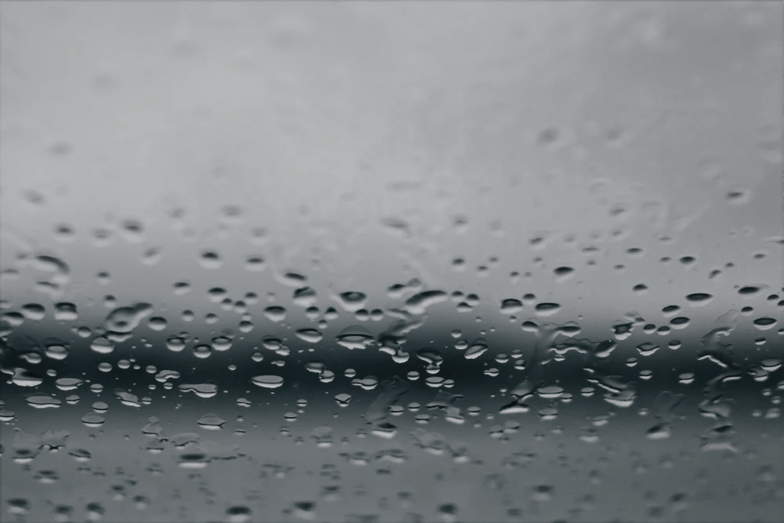
Finding sounds
With a grown up, explore some different rainy sounds around your house or school like…
tapping a glass bottle
filling a bottle with water and swishing it
a dripping tap
tapping on a tray
rice in a carton
Putting milk onto rice Krispies
I bet you can find loads of ideas
See if you can record some of your fabulous rainy sounds and share them with someone else
Can you use one of your rainy sounds to play the drip drop pattern while you sing the song again?

Slide 6
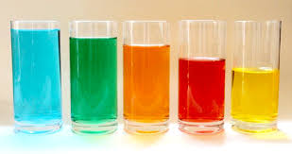
Making sounds
With a grown up, find some glasses or glass bottles / jars and fill them with different levels of water
Try playing your bottles with a spoon
Which one is the highest?
Which one is the lowest?
Can you order them from low to high?
Now try playing them from low to high and high to low

Slide 7
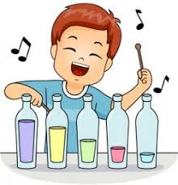
Raindrop music
Using your set of water sounds, try playing them in any order to make your own tune
You could give each bottle a number and then write down your tune using the numbers like this
Then you can play it again and again
4
3
3
2
2
1

Slide 8
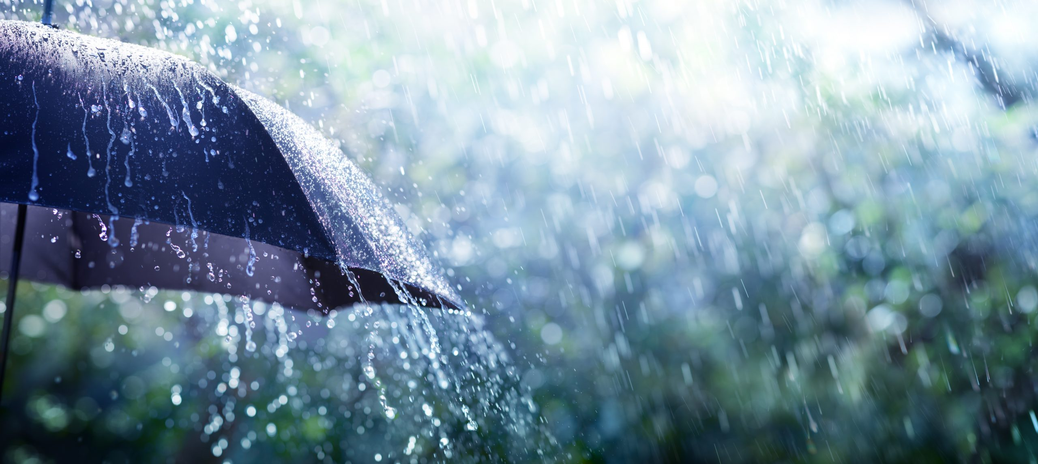
What do you like to do in the rain?
What do you like to do in the rain?
Some people like to dance in the rain like this: Rain dancing
Some people like to jump in puddles like this: Puddle jumping
Some people like to stay inside and watch the raindrops splash down the window like this: Rain sounds
Some people like to sing in the rain like this: Rain singing
What’s your favourite thing to do in the rain?
Notes:
Guide to the clips:
Rain dancing – Mr Tumble clip
Puddle jumping – Sesame street
Rain sounds – 30 minutes ambient rain
Rain singing – classic clip from the film

Slide 9
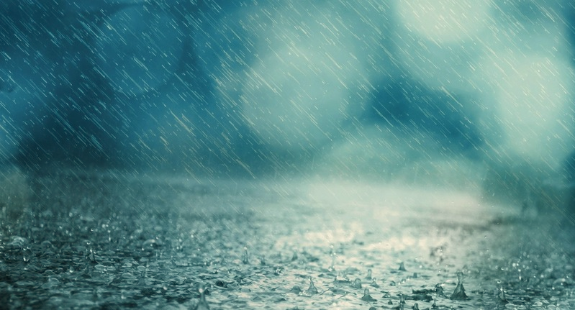
If you still have time…
Watch these children making a rainstorm sound with their body sounds
Rainstorm
Can you try making these different sounds too?
If you have someone else to work with, you could try building up the sounds to make a rainstorm
Put your rainstorm sounds and your raindrop tune together to tell a musical story about your rainy days and record your performance to share with someone special

Slide 10
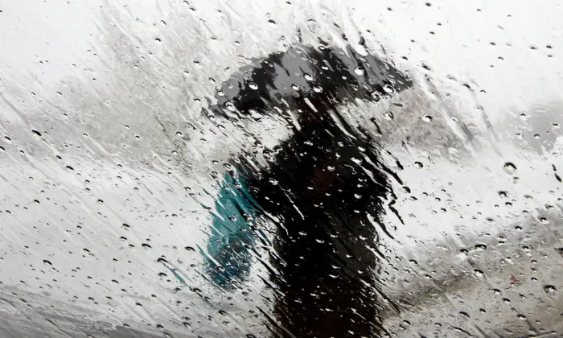
And remember…

Slide 11
After the rain…. the sun always comes

Slide 12
Have a fabulous day

